Slide 1



My Christmas
Jesús Digón Abia
2ºDAW

Slide 2

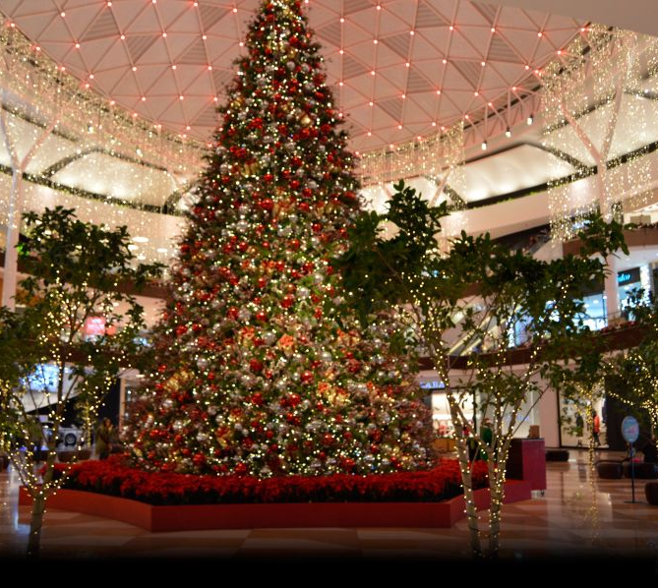

My experience in the shopping centers

Slide 3
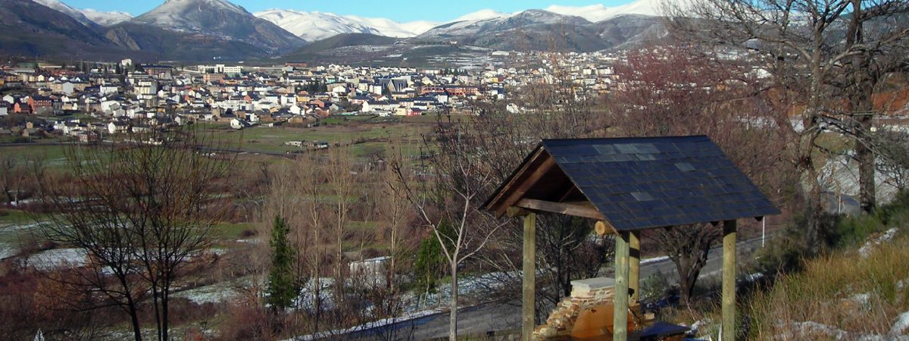
Visiting my father

Slide 4
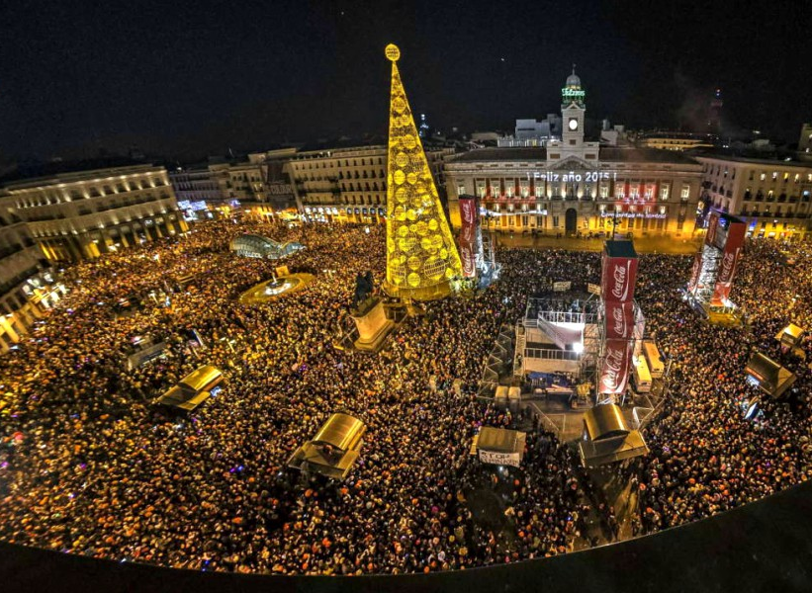
Christmas and New Year´s Eve

Slide 5
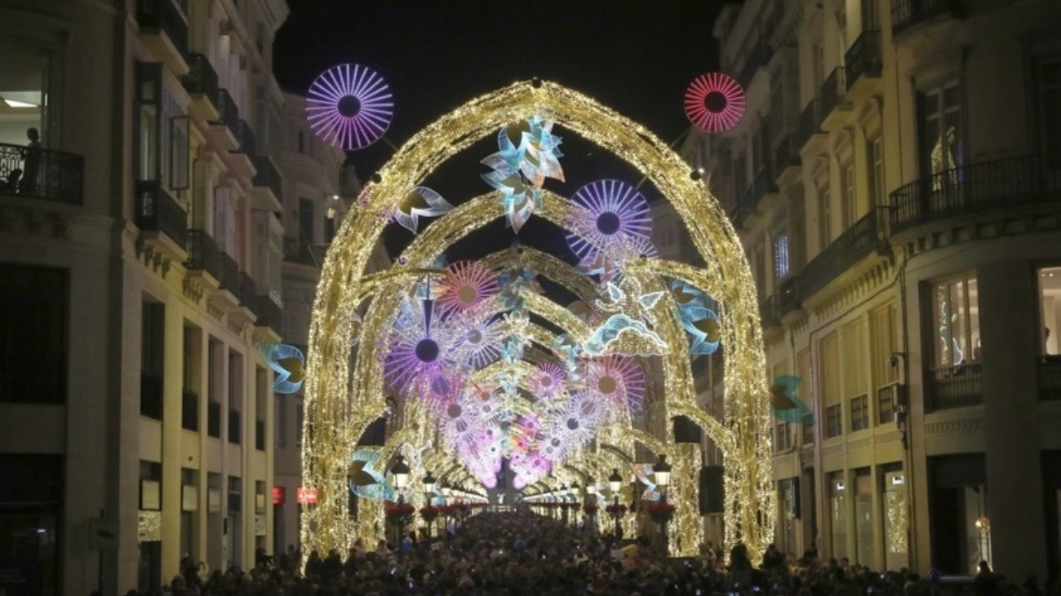
Málaga´s Christmas lights

Slide 6
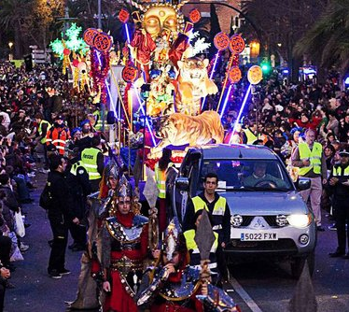
Cavalcade of the Three Kings

